Slide 1
Automatic Thoughts
https://www.youtube.com/watch?v=m2zRA5zCA6M
Stopping Negative Thoughts
https://www.youtube.com/watch?v=_XLY_XXBQWE
Negative thinking:
https://www.youtube.com/watch?v=x-dMPXBl7yA&t=20s
Directions for printing:
Delete pages you don’t need or want.
Add a text box anywhere to add your name or message.
(Hack: add a white shape box over any text you want to delete. Works like white-out. Then add a text box or image over that shape.)
Export or save file as a pdf.
Print double sided and fold.

Slide 4
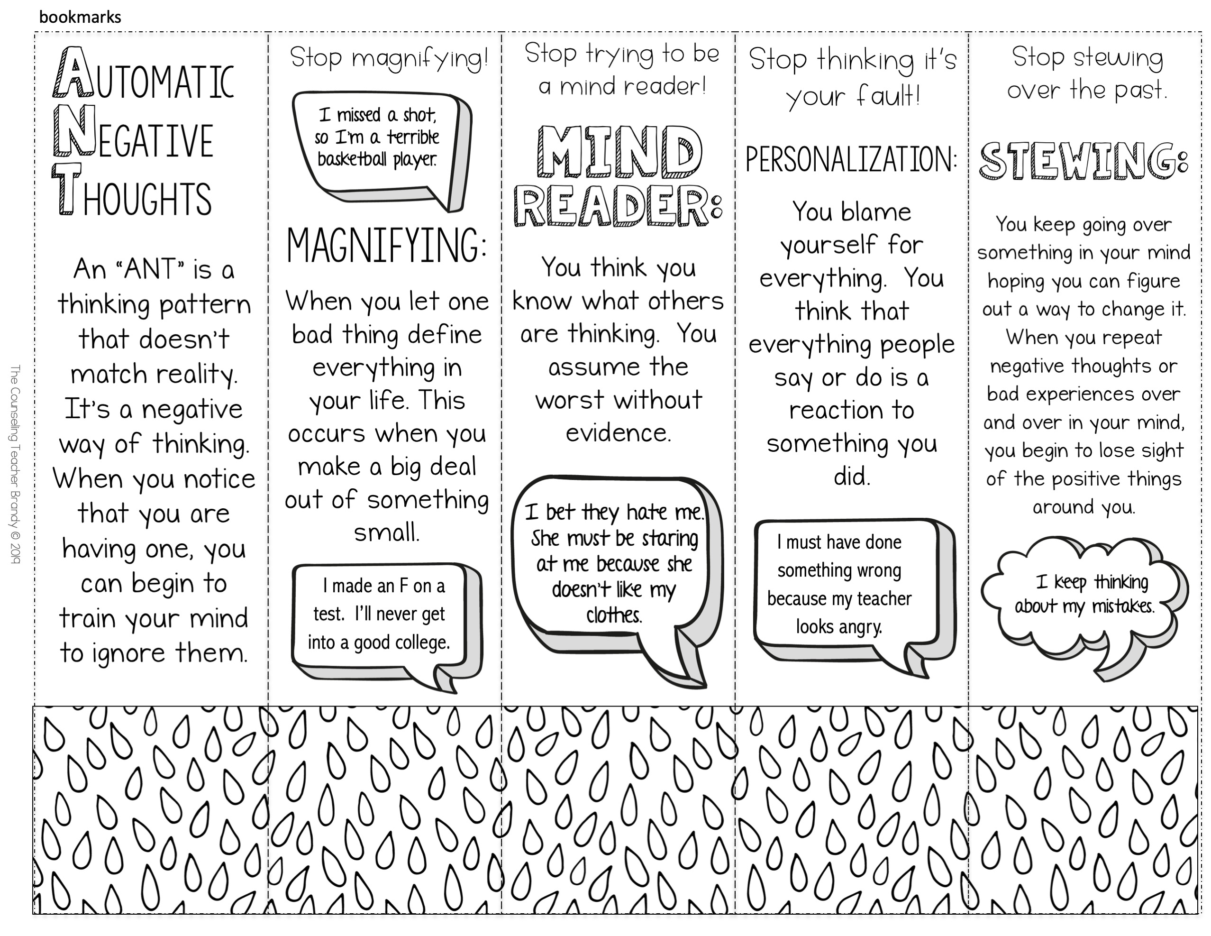

Slide 5
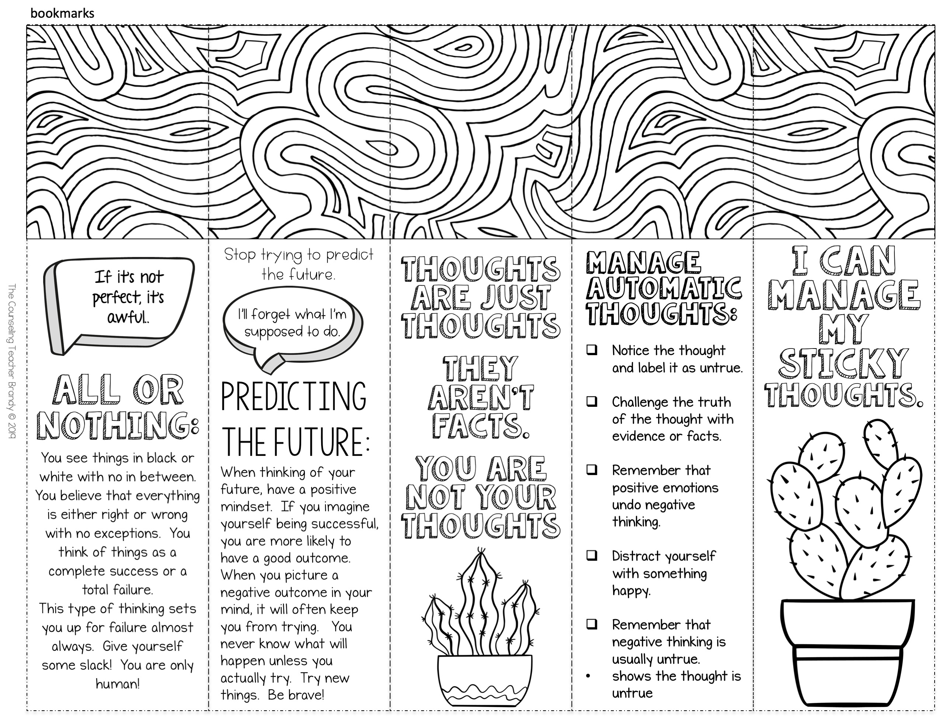

Slide 7
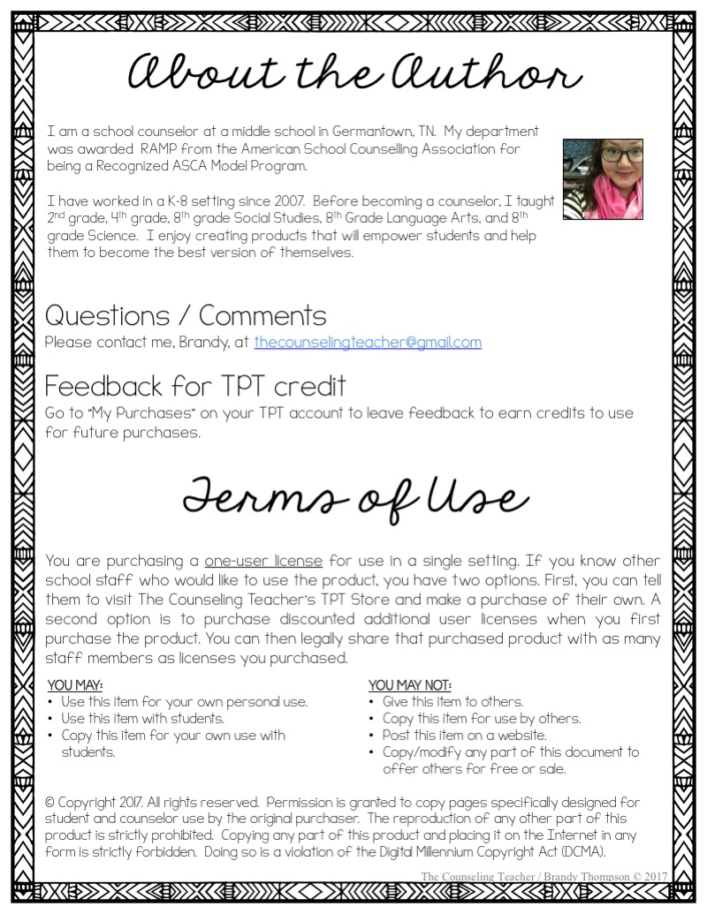
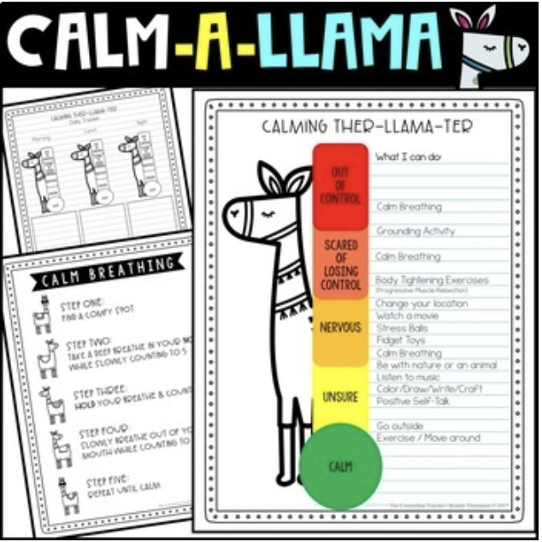
You might also like:
https://www.teacherspayteachers.com/Product/Growth-Mindset-Activities-and-Mindfulness-Journal-Bundle-Grades-1-8-4451792
https://www.teacherspayteachers.com/Product/Worry-and-Anxiety-Coping-Skills-Workbook-3515127
Carrie Stephens Art!
https://www.teacherspayteachers.com/Store/Carriestephensart
https://www.teacherspayteachers.com/Store/Bricks-And-Border

Slide 8
K-2: http://bit.ly/2GeEljs
3rd – 8th: http://bit.ly/2JyDHPZ
Teens / high school:
https://www.teacherspayteachers.com/Product/Social-Emotional-Learning-Brochures-for-Teens-4913020
Storage for your brochures:
https://amzn.to/2FB1xrV

